Slide 1
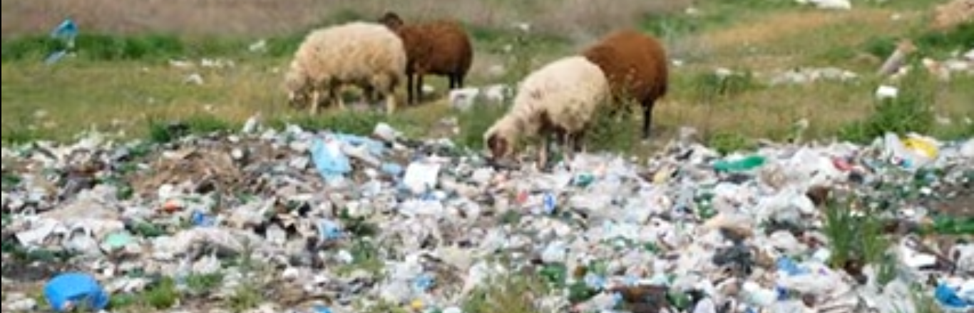
What can I do about litter?

Slide 2
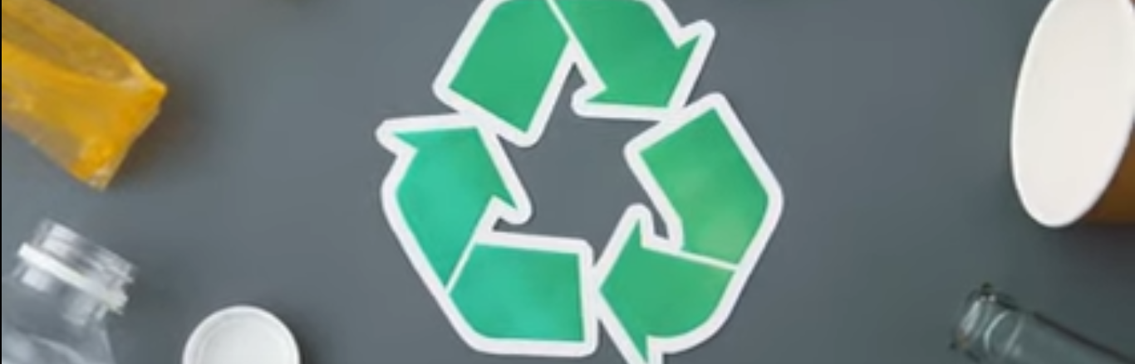
There are some actions we can take to reduce litter

Slide 3
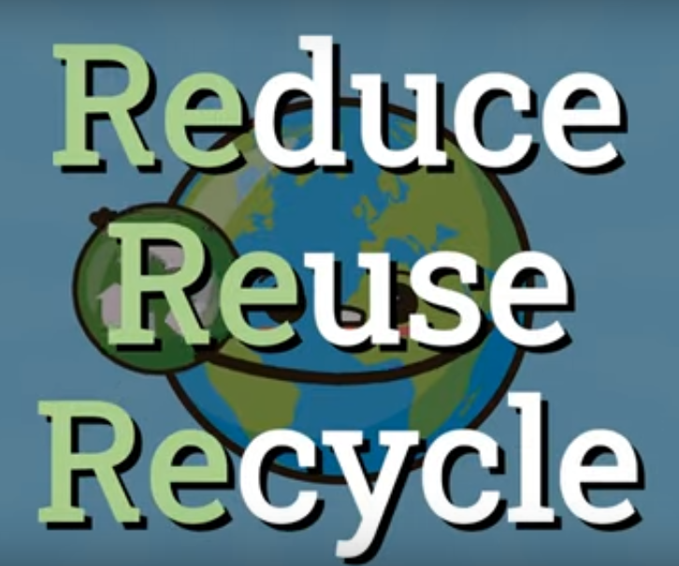
I can REDUCE, REFUSE REUSE, and RECYCLE.

Slide 4
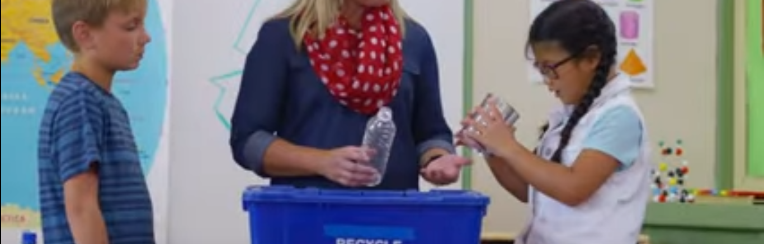
I can dispose garbage properly.

Slide 5
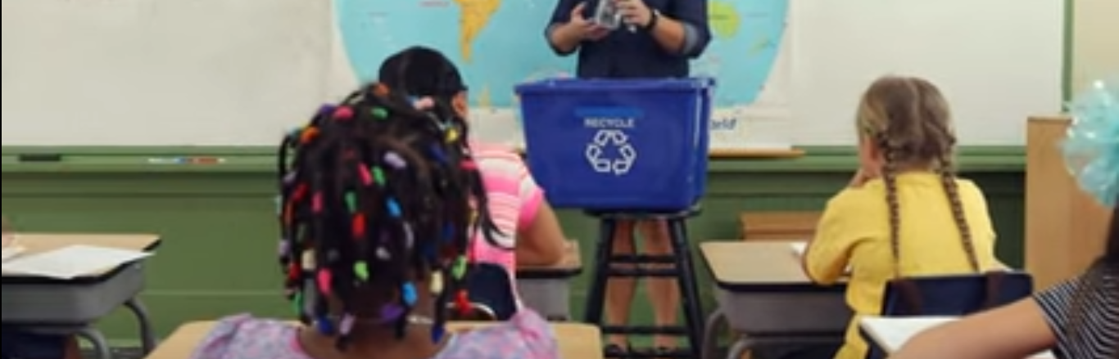
We can clean our school.

Slide 6
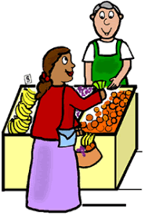
We can buy less packaged food

Slide 7
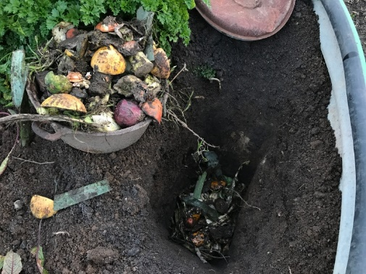
I can use a compose bin to dispose food

Slide 8
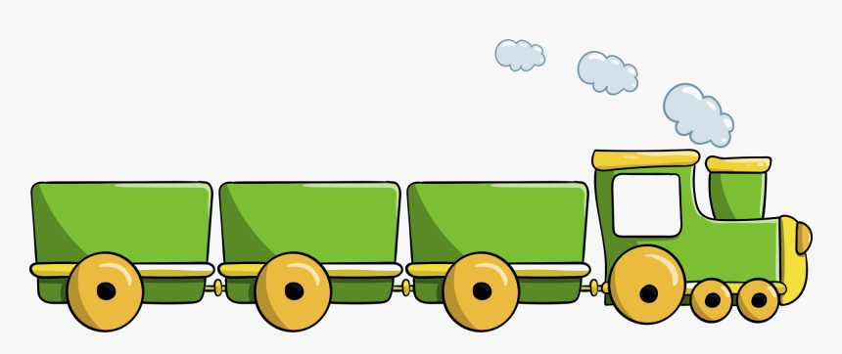
Sequence words
First
After that
Then
Finally

Slide 9

Recycling to reduce litter
First, items/products to be recycled need to be collected.
Then, put your recyclable items into the proper container to be collected.
After that, in the recycling center the articles must be sorted into different categories: like paper, glass, aluminum and plastic.
Finally, the recyclable items must be processed.
Go green

